Slide 1
Marijuana (Cannabis) Legalization: Implications for Youth Use Prevention
Many thanks to the Office of Behavioral Health Wellness, Virginia Department of Behavioral Health and Developmental Services for funding this presentation
February 2022

Slide 2
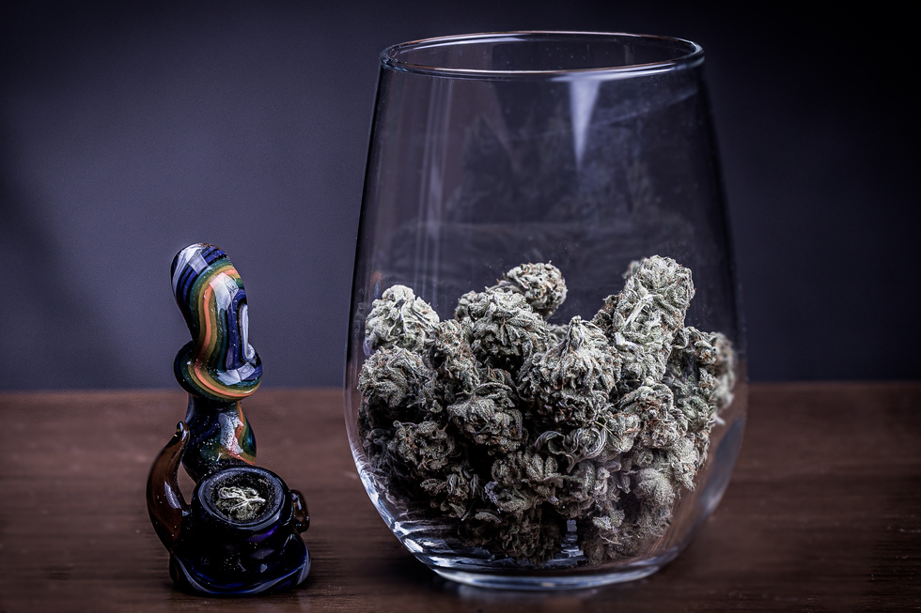
Youth Marijuana Use - Competing Influences
Despite increasing legalization, laws in every state still prohibit teens from
possessing or using marijuana for recreation.
Virginia law, for example, carries a penalty for anyone under 21 years of age found in possession of marijuana or marijuana products in public.
So why has daily marijuana use increased significantly among middle school and
high school students since 2018?
It seems as if marijuana is more available to youth than it ever was and there is an ongoing misperception that marijuana is a harmless, all natural, non-addictive substance with no serious side effects, as a result of:
• Efforts to legalize marijuana across the country
• Mixed media messages of popular culture promulgated through television, music, and social media
• Accepted uses of non-psychoactive CBD products
• The promotion of vaping
image: Shadia Amen

Slide 3
Youth Marijuana Use -Teen risk perception decreasing as harms remain the same.
Studies on adolescent behavior have found that as teens’ perception of risk decreases, their risk-taking behavior (e.g., marijuana use) increases.
This is of concern because the evidence shows that early
marijuana use is associated with
•negative impacts on brain development (neuropsychological and neurodevelopmental decline), •poor school performance,
•increased school drop-out rates,
•increased risk for psychotic disorders in adulthood, •increased risk for later depression, and
•suicidal ideation or behavior
•dual use of marijuana and tobacco (nicotine)

Slide 4
National Youth Marijuana Use Data
2020 National Survey on Drug Use and Health:
Use is prevalent.
1 out of 5 people aged 12 or older in the US engaged in past year illicit drug use,
with 84 percent of those reporting using Marijuana.

Slide 5
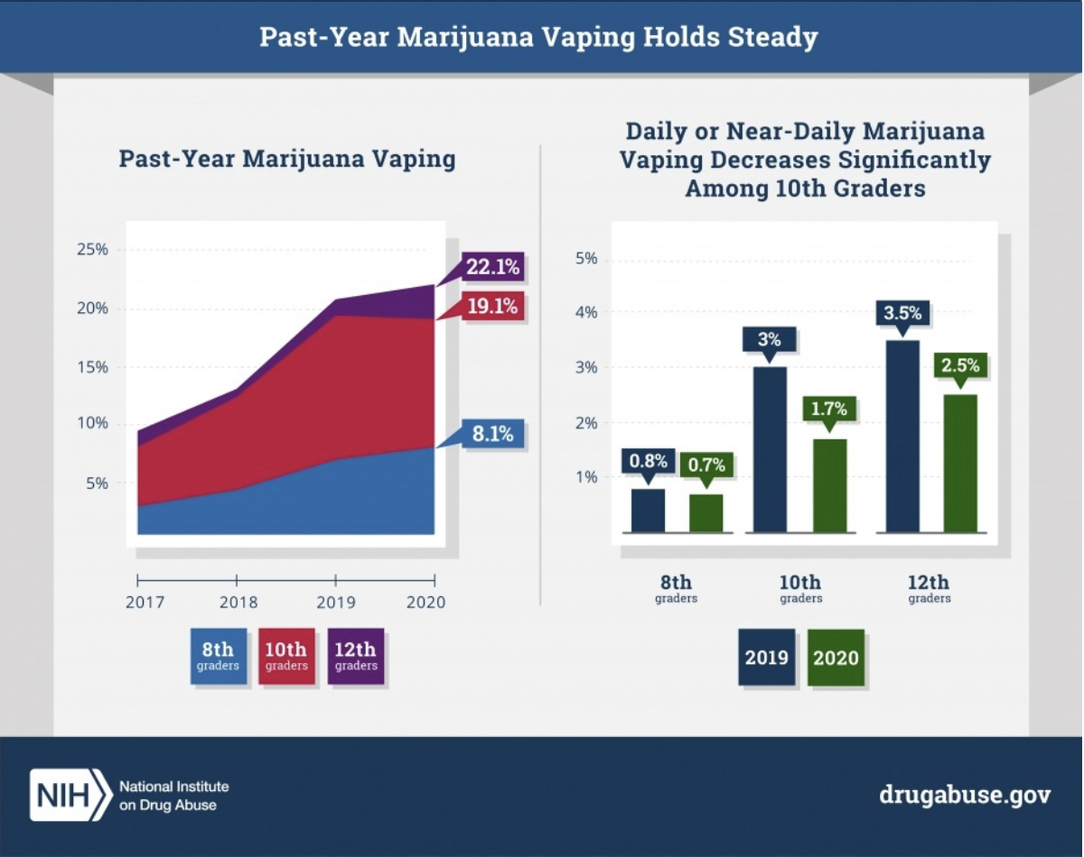
National Youth Marijuana Use Data
2020 Monitoring the Future Survey (NIDA):
•The percentage of teens who vaped marijuana in the past 12 months increased slightly between 2019 and 2020 after a marked increase from 2017.
•In 2020, 8.1% of 8th graders, 19.1% of 10th graders, and 22.1% of 12th graders reported that they vaped marijuana in the past 12 months.
•The percentage of 10th graders reporting daily or near-daily marijuana vaping decreased significantly between 2019 and 2020.
•Less than 1% of 8th graders, 1.7% of 10th graders and 2.5% of 12th graders report daily or near daily vaping of marijuana
in 2020 compared to .8% of 8th graders, 3% of 10th graders and 3.5 % of 12th graders in 2019.

Slide 6
National
Youth Marijuana Use Data
2020 Monitoring the Future Survey (NIDA):
•35% of 12th graders, 28% of 10th graders, and 11.4% of 8th graders have used marijuana in the past year. •6.9% of 12th graders, 4.4% of 10th graders, and 1.1% of 8th graders, use marijuana on a daily basis.

Slide 7
Virginia
Youth Marijuana Use
Data
2019 High School Youth Risk Behavior Survey:
17% of Virginia high school students currently
use marijuana (2019).

Slide 8
What is marijuana?
Marijuana, also known as Cannabis, is made up of seeds, leaves, flowers, and stems from the cannabis plant.
People use it in several forms, including dried and smoked, vaped, or ingested in baked goods. Marijuana contains over 400 hundred chemicals.
Two main chemicals are non-psychoactive CBD (Cannabidiol) and psychoactive THC (Delta-9-
tetrahydrocannbidio).
Research studies show that, while CBD is non-addictive and non-intoxicating, THC, however, is addictive and can have adverse effects on the brain.

Slide 9
How does marijuana work?
According to the National Institute on Drug Abuse, THC’s chemical structure is similar to a brain chemical called anandamide.
Anandamide sends chemical messages between nerve cells
(neurons) throughout the nervous system and affects brain areas that influence pleasure, memory, thinking, concentration, movement, coordination, and sensory and time perception.
Because of its similarity to anandamide, THC can also message or activate neurons, disrupting various mental and physical functions.

Slide 10
How does marijuana work?
•THC, mimicking anandamide, activates the brain’s reward system, which includes regions that govern the response to healthy pleasurable behaviors such as sex and eating.
•THC stimulates neurons in the reward system to release dopamine, a signaling chemical, at levels higher than typically observed in response to natural rewarding stimuli.
•This surge of dopamine creates a high or feeling of pleasure, and “teaches” the brain to repeat the rewarding behavior, helping account for marijuana’s addictive properties.
•The developing adolescent brain relies heavily on the brain’s reward center, which makes teens more sensitive to the effects of dopamine and at greater risk of addiction.

Slide 11
Short and Long-term Consequences of Youth Marijuana Use
In addition to the risk of addiction, marijuana use leads to other short-and long-term consequences.
Short-term effects from marijuana use include
feelings of relaxation or demotivation;
increased heart rate;
loss of coordination and slower reaction times;
altered sense of time;
increased appetite; and
feelings of anxiety, fear, distrust, and panic.
Marijuana use over a long period of time can cause respiratory problems and make it difficult to retain and process information.
image: Tommaso Novi

Slide 12
Short and Long-term Consequences of Youth Marijuana Use
Marijuana use among teens increases the risk of academic problems.
How?
THC impacts the hippocampus, a part of the brain responsible for cognitive functions including
attention, critical thinking, processing, and storing new information.
Impaired focus and concentration have serious implications for student learning and achievement. In addition, marijuana use among teens has also been linked to lack of motivation, which may be
the cause for school absences and drop-out rates.
image: Zeynep Kucuk

Slide 13
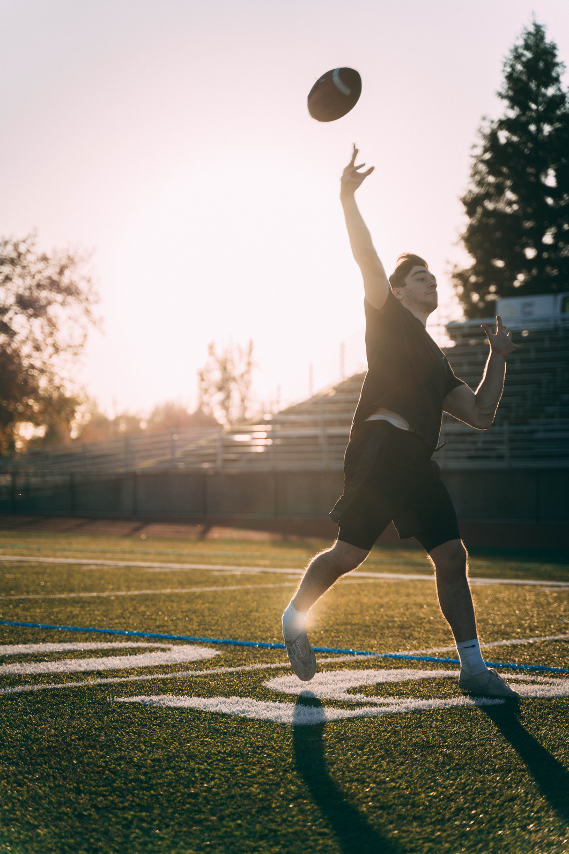
Short and Long-term Consequences of Youth Marijuana Use
Athletic performance can also be affected by marijuana use.
THC also affects parts of the brain that control motor skills such as reflexes and coordination, which are critical for athletic performance.
Even cognitive and motor functions that are diminished for a short period of time can increase the risk of a serious injury, which has implications for youth sport concussions.
image: Matthew Justice

Slide 14
Short and Long-term Consequences of Youth Marijuana Use
Many teens will learn to drive an automobile during their adolescent years, which makes safe driving a serious concern.
This is because the same capabilities that teens need to perform well in school and in sports, such as concentration, critical thinking, and motor skills are the same skills necessary for safe driving.
And THC impairs these functions and can increase the risk of crashes.

Slide 15
National Policy Statements Urge Caution
The increasing accessibility of marijuana is concerning to several national health organizations.
They have issued statements
to caution about risks to youth and urge a range of strategies to be deployed to minimize harm to youth.
Source:
Preventing Marijuana Use Among Youth)

Slide 16
How is Marijuana Used?
In order to effectively prevent youth marijuana use, it is important to understand how it is used.
The information that will be presented now is from--
SAMHSA Evidence Based Resource Guide Series: Preventing Marijuana Use Among Youth

Slide 17
How is Marijuana Used?
Youth are using marijuana via all of the routes illustrated below, especially edibles and concentrates.
How people use marijuana has changed substantially over the years. In addition to smoking traditional marijuana cigarettes, a vast array and combinations of manufactured products have evolved.
These include:
•edibles,
•marijuana-infused beverages,
•topical applications
•various devices for inhalation.
There has also been an increase in people using products originally designed for nicotine/tobacco for marijuana, such as blunts, vaporizing devices, and
e-cigarettes.

Slide 18
How is Marijuana Used?
Youth are using marijuana in all these ways, especially edibles and concentrates.
Foods and beverages are being e infused with THC, including products such as:
•brownies and cookies,
•candies such as gummies and lollipops, sodas, and
•alcoholic beverages such as wine and beer.
Edible marijuana products are packaged similarly to non-marijuana products (e.g., gummies).
This makes them attractive to youth.

Slide 19
How is Marijuana Used?
Another way youth are attracted to marijuana is through flavoring.
•Using sweet flavoring (e.g., orange soda) for marijuana- infused beverages.
•Flavoring marijuana products such as vaping concentrates or hemp wrappers used for blunts.
Another marketing strategy names marijuana products to imply fruit or other flavors (e.g., grape, peanut butter cup, or pineapple haze), even if that fruit/ flavor is not present.

Slide 20
How is Marijuana Used?
The ability to avoid detection may be one reason why vaping marijuana has become increasingly popular among youth.
NIDA.gov
Vaping liquid marijuana products can lack the characteristic smell of marijuana, making detection of use difficult.
Vaping devices are also packaged in ways that resemble memory sticks or other non-drug paraphernalia devices.

Slide 21
Promising Environmental Strategies to Prevent Youth Use- lessons from other states
Despite the relaxing of social norms and policies, marijuana is a significant youth public health concern.
This table from Preventing Marijuana Use Among Youth identifies promising environmental prevention strategies being used across the US.
These state and local strategies
aim to
•increase penalties and price,
•decrease the availability, attractiveness, and promotion of youth marijuana use.

Slide 22
Instructional Resources
This presentation was based on a resource article that can be found on the home page of Health Smart VA.org. That article offers numerous resource links to organizations including
The National Institute for Drug Abuse and the Cannabis Awareness and Prevention Toolkit from
Stanford Medicine.
The grade level pages of Health Smart Virginia also provide numerous instructional resources to be
used for substance misuse prevention.

